Slide 1
SAVEETHA SCHOOL OF ENGINEERING
CSA0888-PYTHON PROGRAMMING FOR NATURAL LANGUAGE PROCESSING
Tic Tac Toe Quest: Master the Board
PRESENTED BY:
N.Pranith (192210437)
D.Bharath(192210393)
Guided by:
Dr.E.Anbalagan

Slide 2


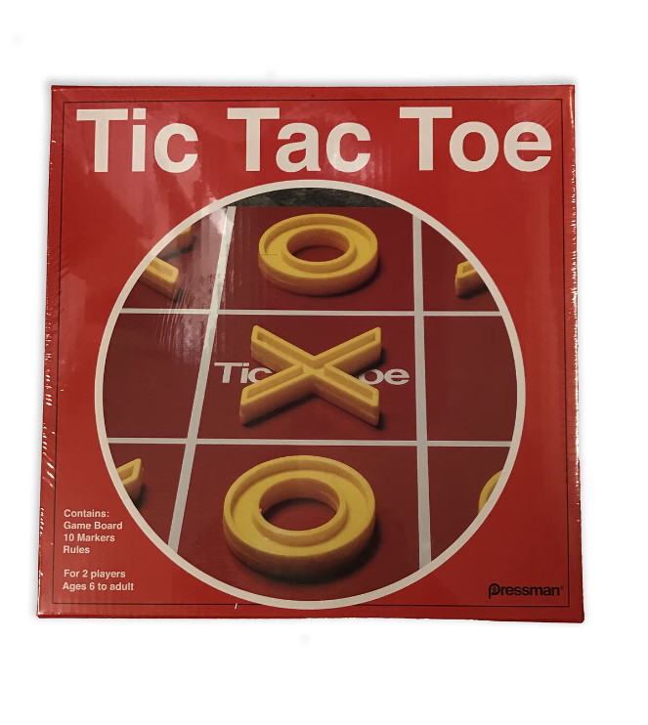
Introduction
Game Design
User-friendly Python-based tic-tac-toe game for all skill levels
Game Overview
Classic game of getting 3 symbols in a row, simple yet strategically deep
Key Features
Clean interface, play vs computer, save/load games, track stats
Design Goals
Balanced and fair experience through careful algorithm design

Slide 3

Objective
1
Gameplay
2
User Interface
To develop a functional tic-tac-toe game where two players can compete against each other.
To create an intuitive and visually appealing interface that enhances the user experience.
3
Logic
4
Gameplay Modes
To implement the core logic of the game, including move validation, win detection, and turn management.
To allow players to choose between playing against another human or against a computer AI.

Slide 4

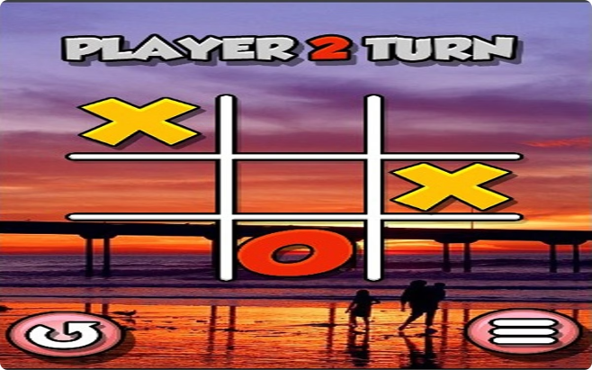
Abstract
Game Design
Aims to create a playable tic-tac-toe game in Python with a graphical user interface (GUI)
Game Logic
Implemented using functions and data structures for efficient gameplay and win detection
GUI Experience
Provides visually appealing and intuitive gameplay for all users
Project Showcase
Demonstrates Python's versatility in creating interactive gaming applications

Slide 5

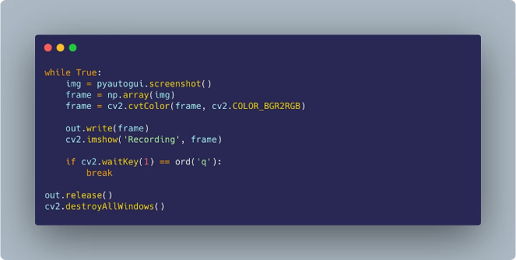
Advantages of the Proposed System
Flexibility
The Python programming language offers flexibility and allows for easy modifications and enhancements to the game.
Cross-Platform Compatibility
Python is a cross-platform language, ensuring the game can be played on different operating systems.
Community Support
Python has a large and active community, providing extensive documentation and resources for game development.
Ease of Use
Python's syntax is known for its simplicity, making it an approachable language for beginners.

Slide 6
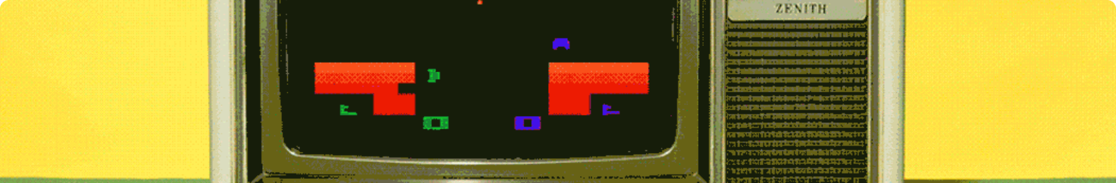
Disadvantages of the Existing System
Traditional tic-tac-toe games often rely on physical boards and markers, which can be cumbersome and limited in terms of replayability and customization. This classic game, however, is about to undergo a digital transformation that will revolutionize the way it's played.
By leveraging the power of modern technology, our tic-tac-toe game offers a seamless and immersive experience that transcends the constraints of physical game pieces. Players will be able to engage in endless rounds of strategic gameplay, each with the ability to customize the board, pieces, and even the overall aesthetic to their liking.
Gone are the days of misplaced markers and limited replay value. Our digital adaptation of tic-tac-toe provides a dynamic and adaptable platform that caters to players of all ages and skill levels. Whether you're a seasoned strategist or a newcomer to the game, you'll find yourself captivated by the endless possibilities that our virtual tic-tac-toe experience has to offer.

Slide 7

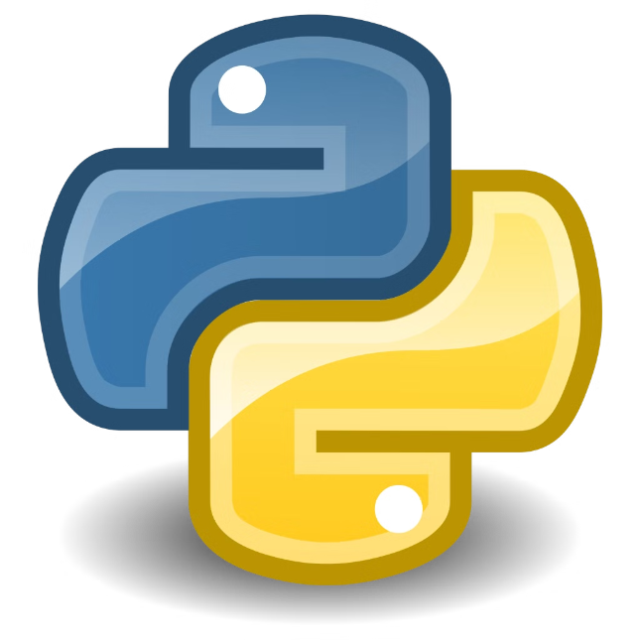
Methodology
1
Design
Conceptualize the game's interface, gameplay mechanics, and logic flow.
2
Implementation
Write Python code to implement the game's logic, user interface, and functionalities.
3
Testing
Thoroughly test the game to ensure accurate gameplay, win detection, and bug-free performance.

Slide 8
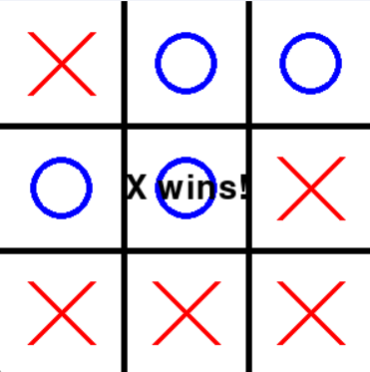
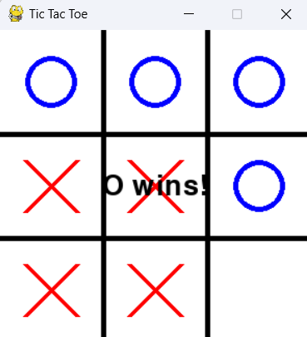
Results and Discussion
Gameplay
The game is playable and offers a fun and engaging experience. Players can compete against each other or against an AI opponent.
User Interface
The GUI is intuitive and easy to use. Players can easily make moves and understand the game's rules.
Logic
The game's logic works as intended, accurately detecting wins and enforcing turn-based gameplay.

Slide 9

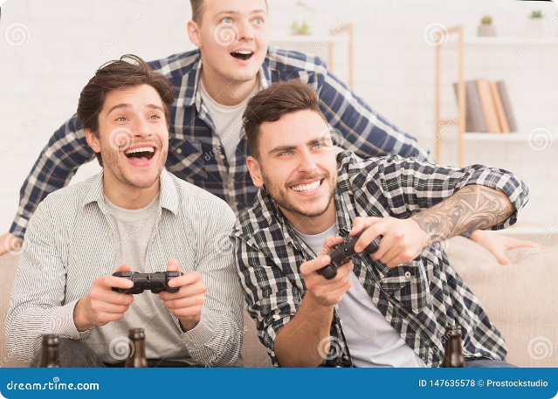
Conclusion
This Python-based tic-tac-toe game caters to players of all skill levels, from seasoned strategists to newcomers. Its intuitive interface and seamless gameplay ensure an engaging and enjoyable user experience.
The game's core strength lies in its ability to accommodate players of diverse backgrounds, offering a level playing field for strategic challenges and the thrill of outsmarting opponents.
As the project progresses, the team plans to explore enhancements and integrations to expand the game's reach and appeal to a growing audience.

